Slide 1


Diabetes Prediction using Logistic Regression
A Machine Learning-based Health Care Prediction System
Project by: Khushi Rawat Naviotech Solution Pvt. LTD B.Tech Computer Science Academic Year: 2026
Engineering(AI &ML)

Slide 2

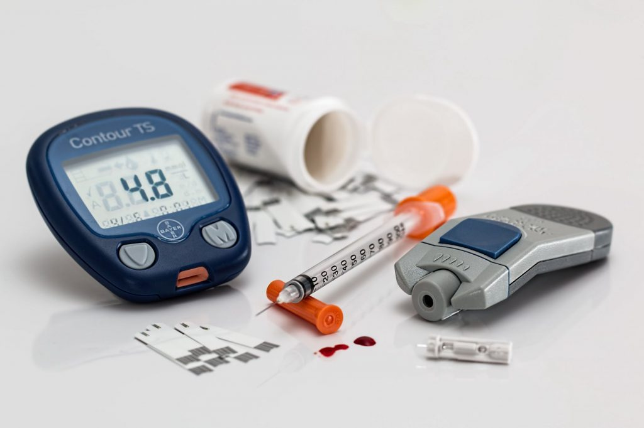
Introduction What is diabetes?
Diabetes is a chronic disease that affects the body ability to regulate blood glucose levels.
It occurs when the body produces insufficient insulin or cannot effectively use the insulin it produces.
Early diagnosis helps prevent serious health
complications such as:
heart disease, kidney damage
and vision loss .

Slide 3

Problem Statement & Objectives
Millions of people remain undiagnosed until serious complications develop.
Manual diagnosis can be time-consuming and may delay treatment.
Early prediction using Machine Learning can support timely clinical decision-making.
Predict diabetes using patient health data.
Develop a Logistic Regression model.
Improve early disease detection.
Support healthcare professionals in decision-making.

Slide 4
Dataset Description
Features
Pregnancies
Glucose
Blood Pressure
Skin Thickness
Insulin
BMI
Diabetes Pedigree Function
Age
Dataset overview
Source: Kaggle (PIMA Indians Diabetes Dataset)
Total Records: 768
Input Features: 8
Target Variable: Outcome (0 = Non-Diabetic, 1 = Diabetic)
The dataset contains patient medical information used to train and test the Logistic Regression model for diabetes prediction.

Slide 5
Methodology 📂 Data Collection ↓ 🧹Data Preprocessing ↓ 📊Feature Scaling ↓ ✂️Train-Test Split ↓ 🤖Logistic Regression Model ↓ 📈Prediction & Evaluation
Patient data is processed, scaled, and used to train a Logistic Regression model, which predicts whether a patient is diabetic or non-diabetic.

Slide 6
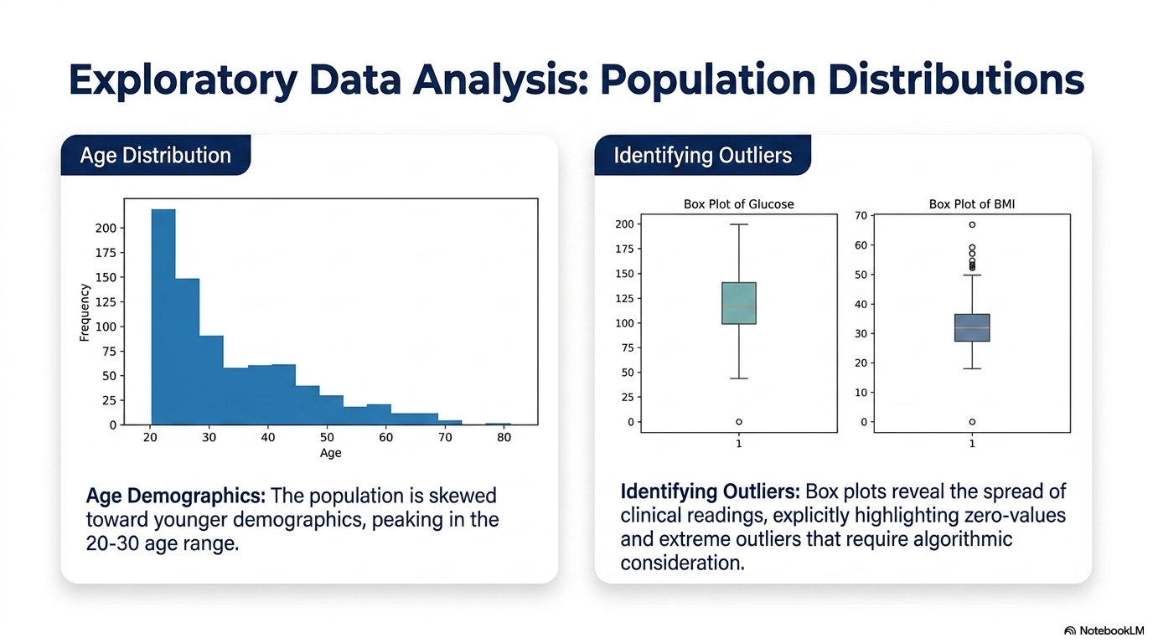

Slide 7
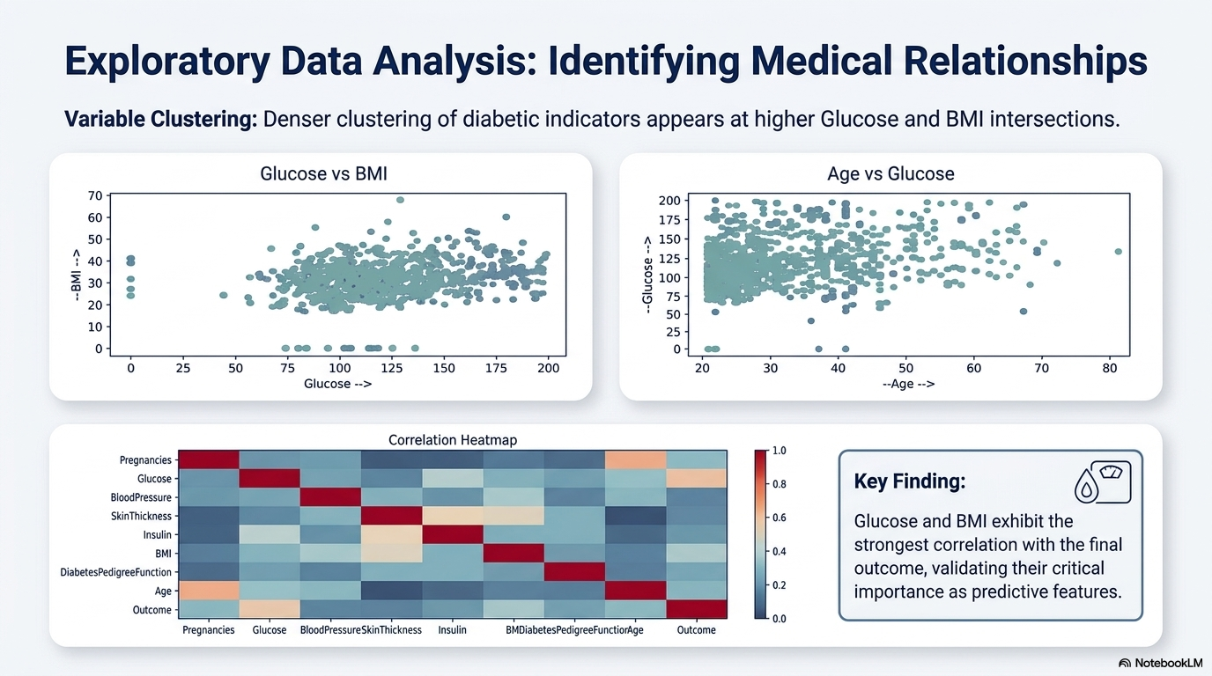

Slide 8

Model Training and Prediction
Model Training
Imported the Logistic Regression algorithm.
Split the dataset into 80% Training and 20% Testing.
Applied StandardScaler for feature scaling.
Trained the model using the training dataset.
Prediction Process
Patient Data
↓
Feature Scaling
↓
Logistic Regression Model
↓
Prediction
(Diabetic / Non-Diabetic)
The Logistic Regression model learns patterns from patient health data and predicts whether a patient is diabetic or non-diabetic.

Slide 9
Model Performance (Accuracy + confusion matrix)
Evaluation Metrics
Algorithm : Logistics Regression. Accuracy Score: Measures the percentage of correctly predicted outcomes.
Confusion Matrix: Represents correct and incorrect classifications.
Results:
The Logistic Regression model achieved good classification performance.
It successfully identified diabetic and non-diabetic cases from test
Key Findings:
✅ The model provided reliable predictions.
✅ Preprocessing and feature scaling improved performance.
✅ Logistic Regression is suitable for binary diabetes classification.

Slide 10
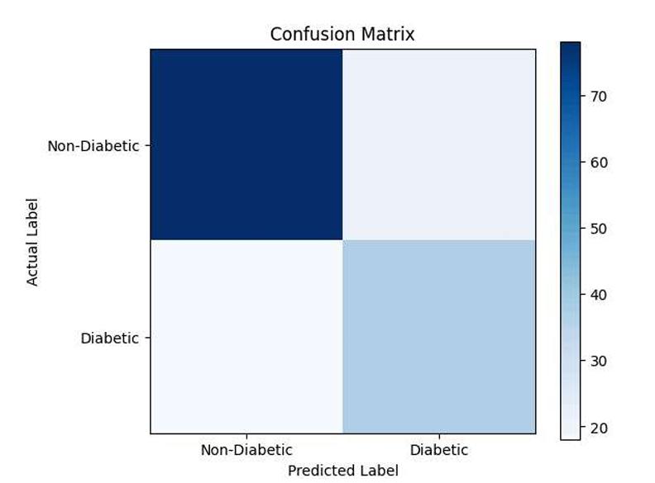
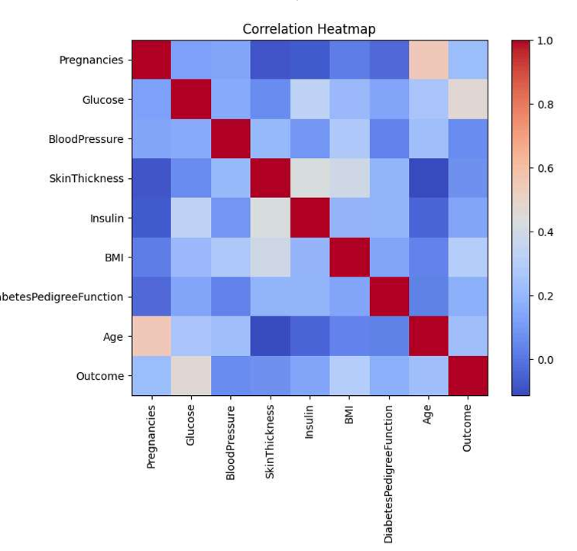

Accuracy score
Confusion Matrix
heatmap

Slide 11
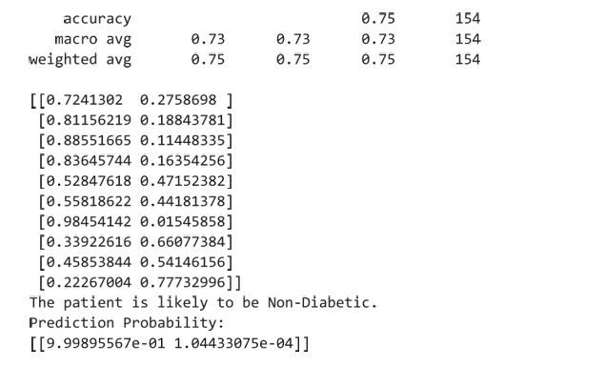
Prediction on New Patient 🧑‍⚕️🤖
Input Patient Data
Pregnancies
Glucose Level
Blood Pressure
Skin Thickness
Insulin
BMI
Diabetes Pedigree Function
Age
Prediction
Patient data is provided to the trained Logistic Regression model.
The model analyzes the input features.
It predicts the outcome as Diabetic or Non-Diabetic

Slide 12

Conclusion and future scope
Conclusion
Developed a Logistic Regression model for diabetes prediction.
Performed data preprocessing and exploratory data analysis (EDA) to prepare the dataset.
The model achieved good prediction performance on the test dataset.
The system can assist in early diabetes detection and support healthcare professionals in making informed decisions.
Future Scope
Improve prediction accuracy using advanced machine learning and deep learning models.
Develop a web or mobile application for real-time diabetes prediction.
Train the model on larger and more diverse datasets.
Integrate the system with hospital information systems for practical healthcare use.

Slide 13

Thank you for your time and attention.

